Slide 1
PAMANTASAN NG CABUYAO ROTC UNIT
PHYSICAL ORGANIZATION

Slide 2
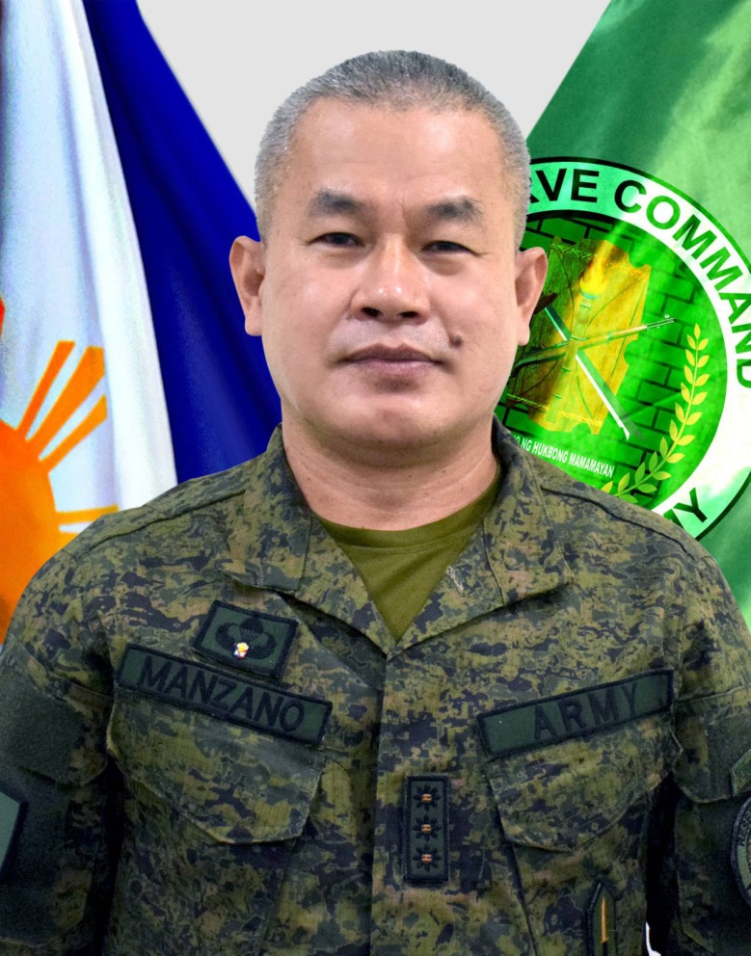
COL SAMUEL B MANZANO INF (GSC) PA ACTING COMMANDER RESCOM, PA

Slide 3
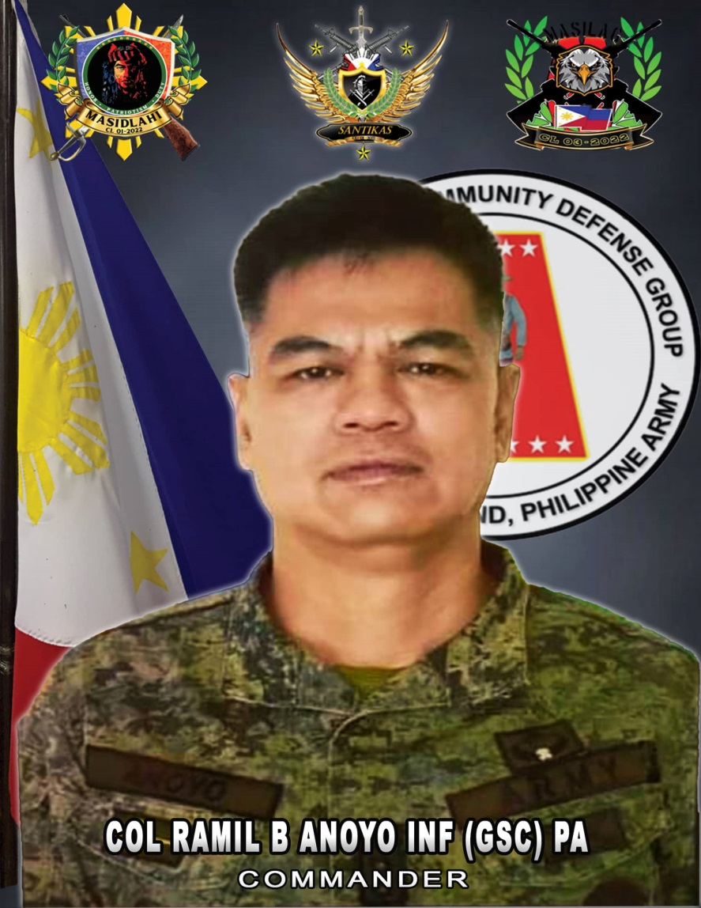
COL RAMIL B ANOYO INF (GSC) PA
GROUP COMMANDER 4RCDG

Slide 4
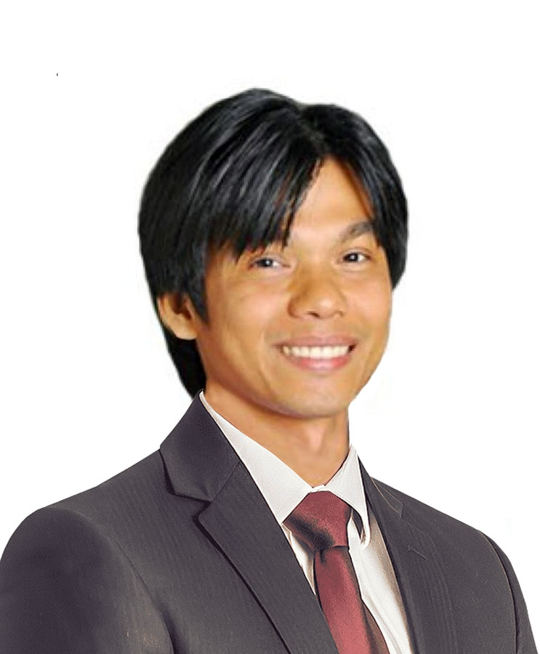
ENGR FLORANTE M ANDAYA
NSTP DIRECTOR

Slide 5
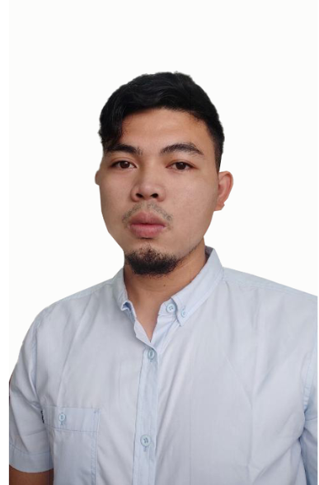
JAN WELHERN B RUFO
ROTC COORDINATOR

Slide 6
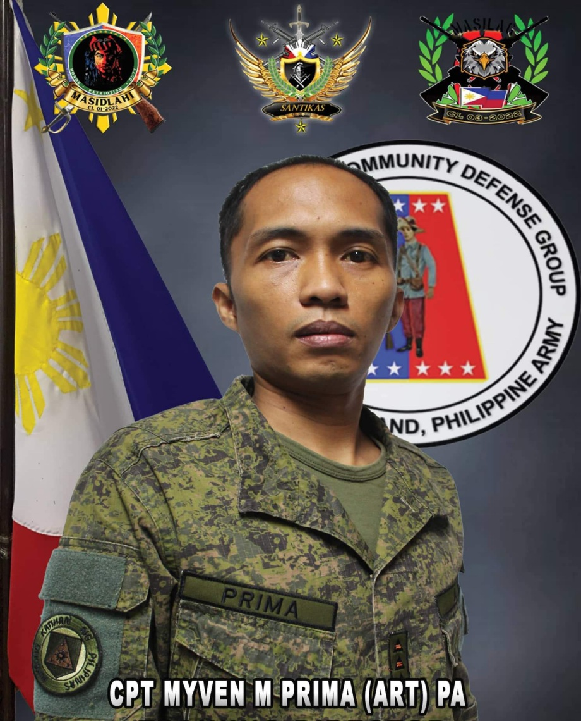
CPT MYVEN M PRIMA (ART) PA
COMMANDANT PNCROTCU

Slide 7
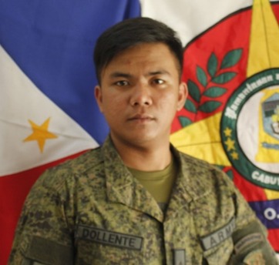
2LT JOHNVHER E DOLLENTE PA (RES)
TACTICAL OFFICER

Slide 8
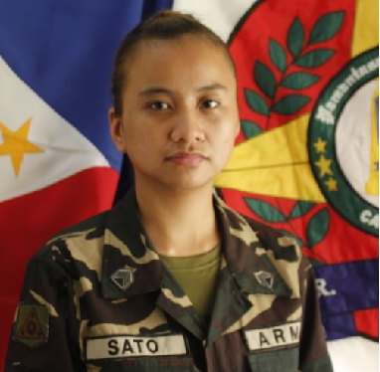
Sgt Krystal S Sato PA (Res)
INSTRUCTOR

Slide 9
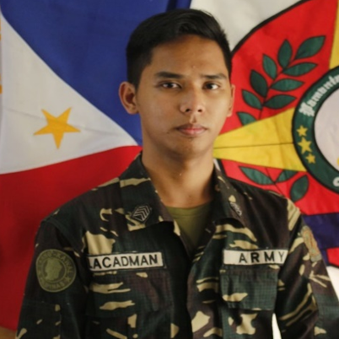
Sgt Rico C Lacadman PA (Res)
INSTRUCTOR

Slide 10
Sgt Bryan General T Rendon PA (Res)
INSTRUCTOR

Slide 11
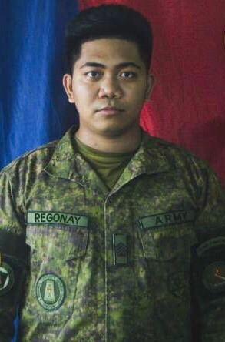
Sgt Nickerson M Regonay PA (Res)
GMA INSTRUCTOR

Slide 12
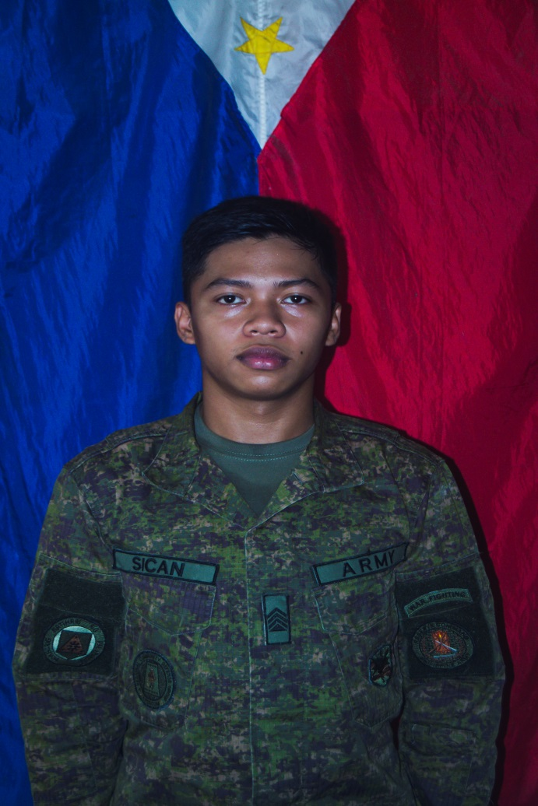
Sgt Loiue John I Sican PA (Res)
GMA INSTRUCTOR

Slide 13
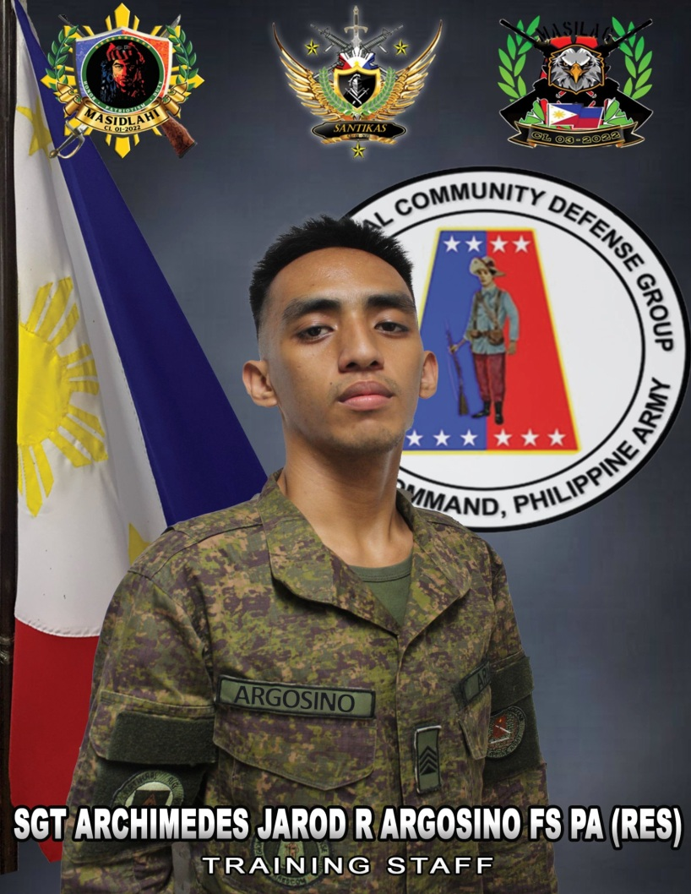
Sgt Archimedes Jarod R Argosino PA (Res)
GMA INSTRUCTOR

Slide 14
Sgt Jhester E Barcellano PA (Res)
GMA INSTRUCTOR

Slide 15
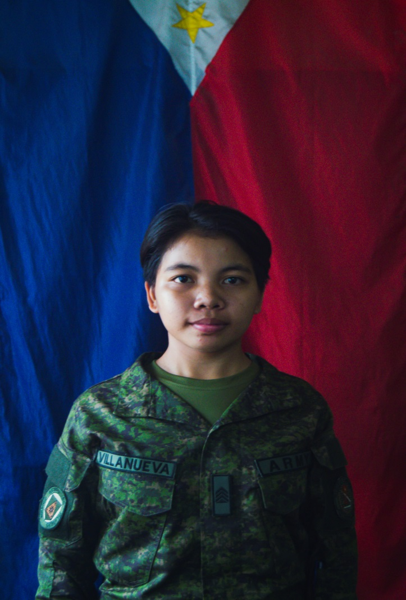
Sgt Andrea G Villanueva PA (Res)
GMA INSTRUCTOR

Slide 16
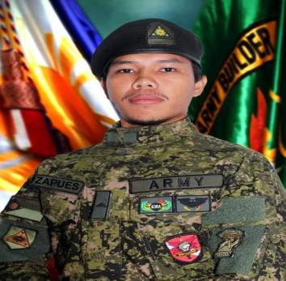
PFC ROMMEL D ZAPUES (INF) PA
ADMIN NCO

Slide 17
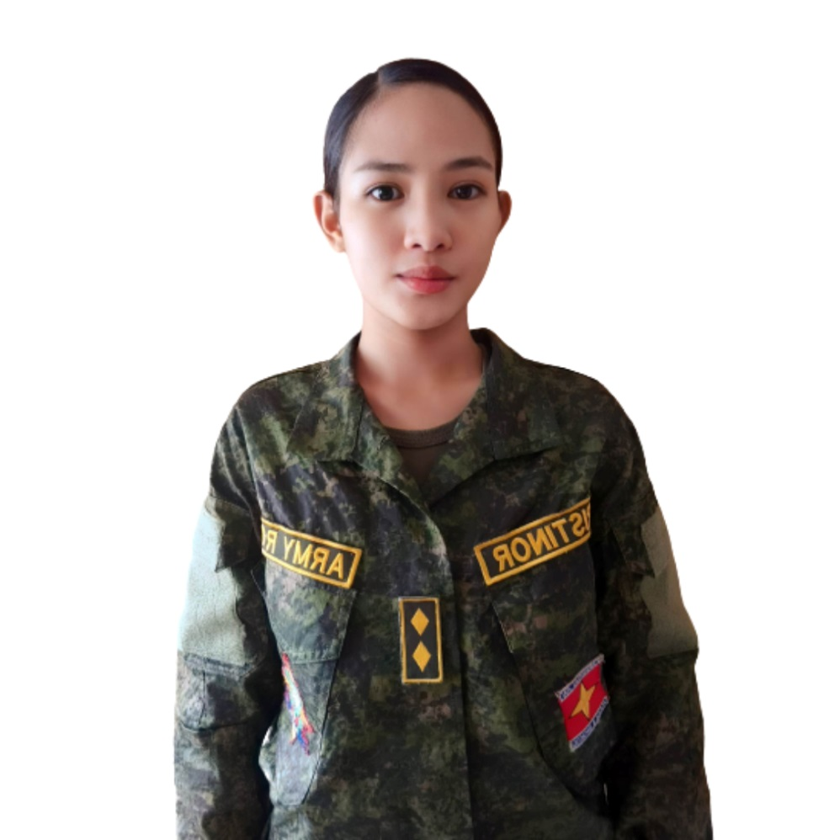
C/COL STEPHANIE NICOLE CRISTINOR (ROTC) 1CL
CORPS COMMANDER

Slide 18
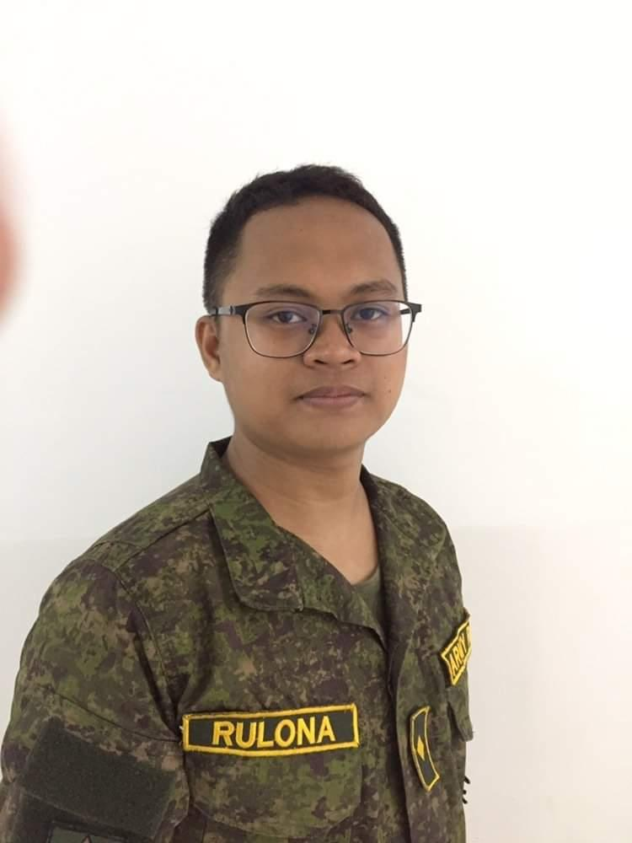
C/LTC REINHEART M RULONA (ROTC) 1CL
CORPS EXECUTIVE OFFICER

Slide 19
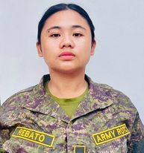
C/LTC MARICEL M REBATO (ROTC) 1CL
CORPS ADJUTANT/PERSONNEL OFFICER

Slide 20
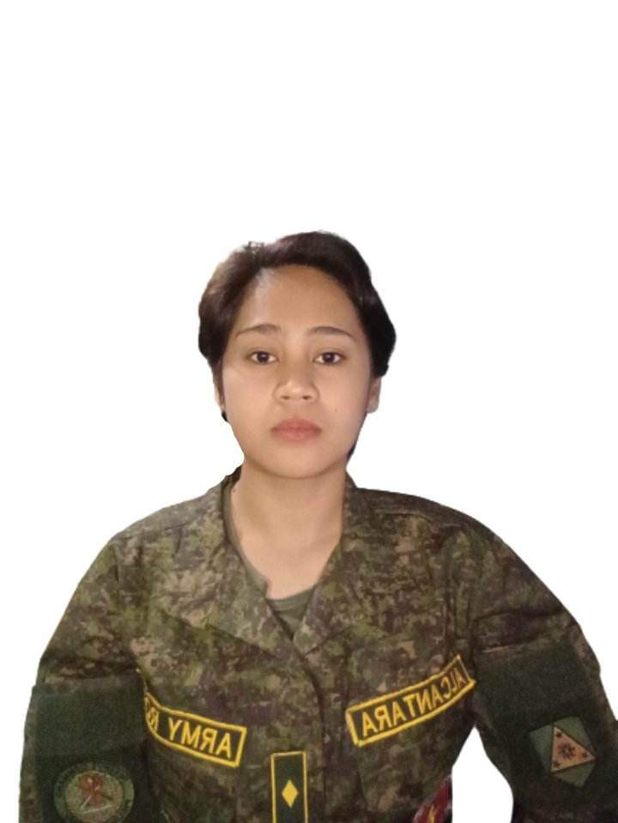
C/LTC LORY JAYNE T ALCANTARA (ROTC) 1CL
CORPS INTELLIGENCE OFFICER

Slide 21
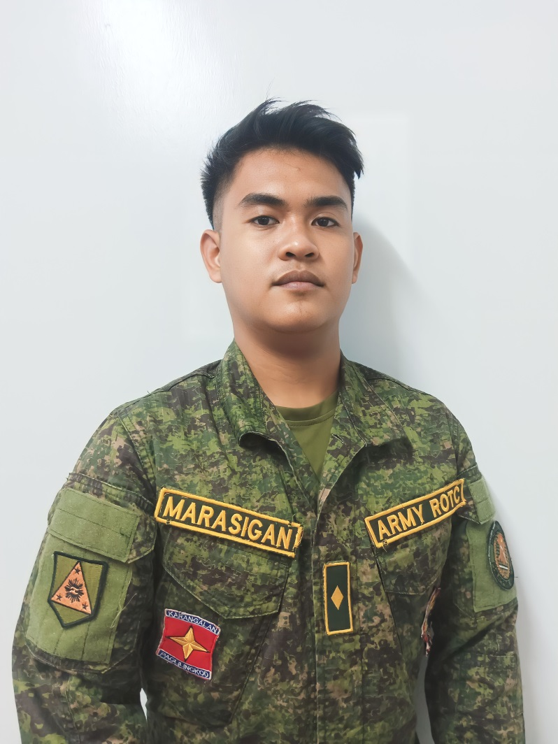
C/LTC MARVIN C MARASIGAN (ROTC) 1CL
CORPS OPERATION OFFICER

Slide 22
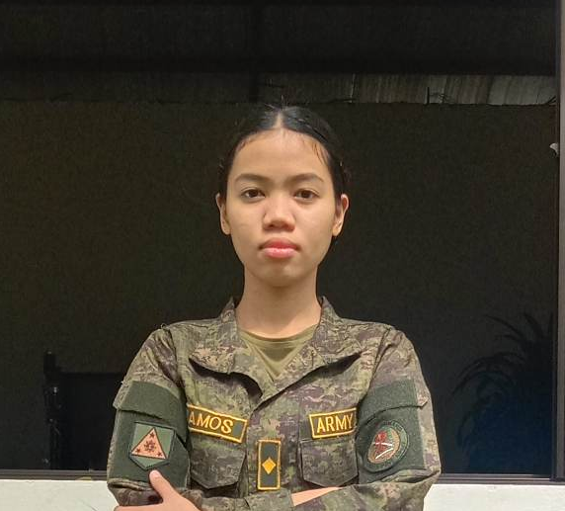
C/LTC PAMELA NICOLE G RAMOS (ROTC) 1CL
CORPS LOGISTIC OFFICER

Slide 23
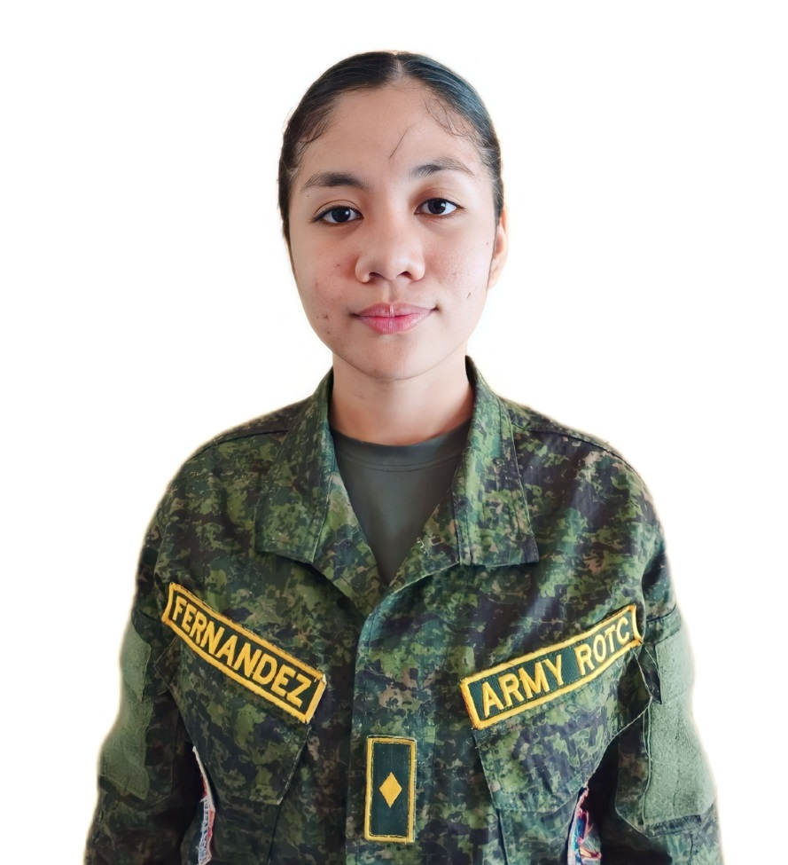
C/LTC DHANNA A FERNANDEZ (ROTC) 1CL
CORPS CMO OFFICER

Slide 24
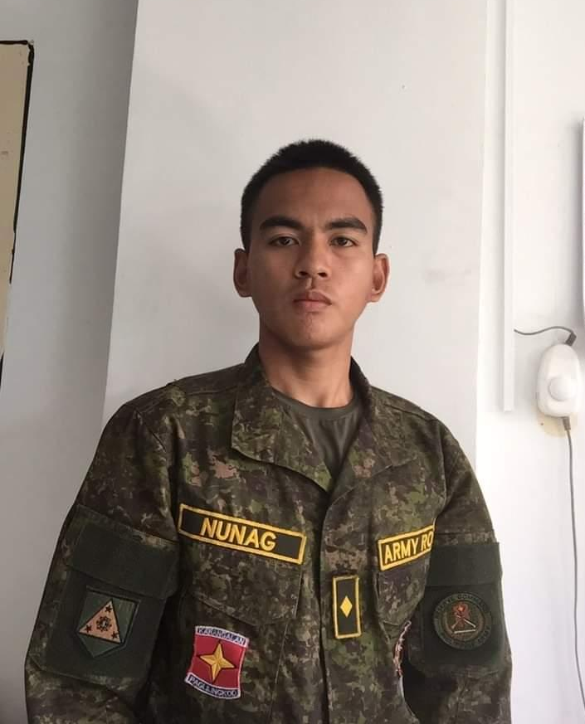
C/MAJ BRYAN JUSTINE L NUNAG (ROTC) 1CL
1ST BATTALION COMMANDER

Slide 25
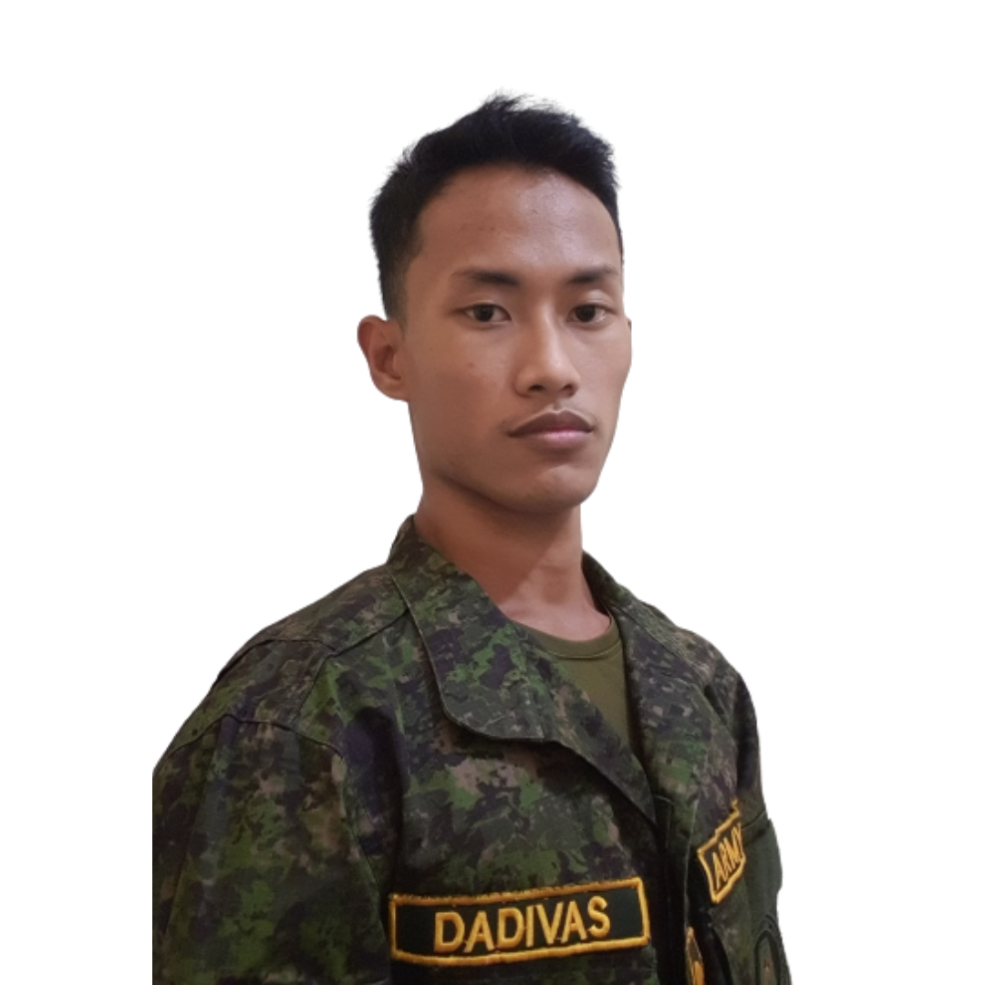
C/CPT JHON EMMANUEL L DADIVAS (ROTC) 2CL
1ST BATTALION EXECUTIVE OFFICER / OPERATION OFFICER

Slide 26
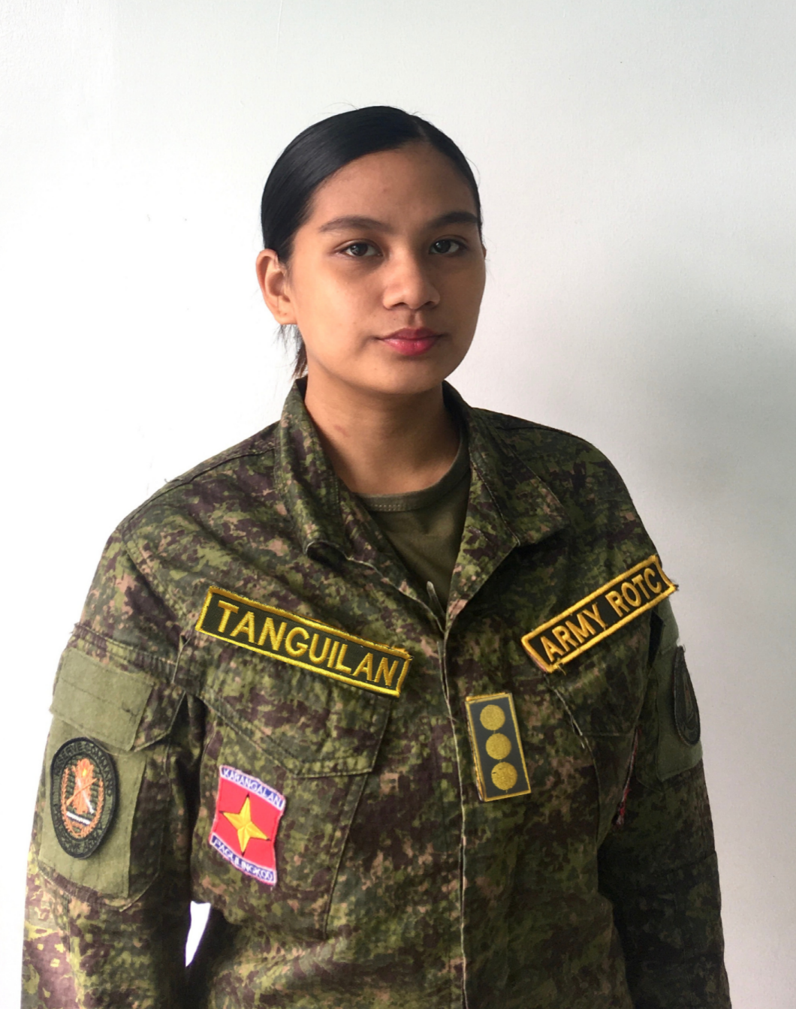
C/CPT MA CHRISTINA C TANGUILAN (ROTC) 2CL
1ST BATTALION ADJUTANT / INTELLIGENCE OFFICER

Slide 27
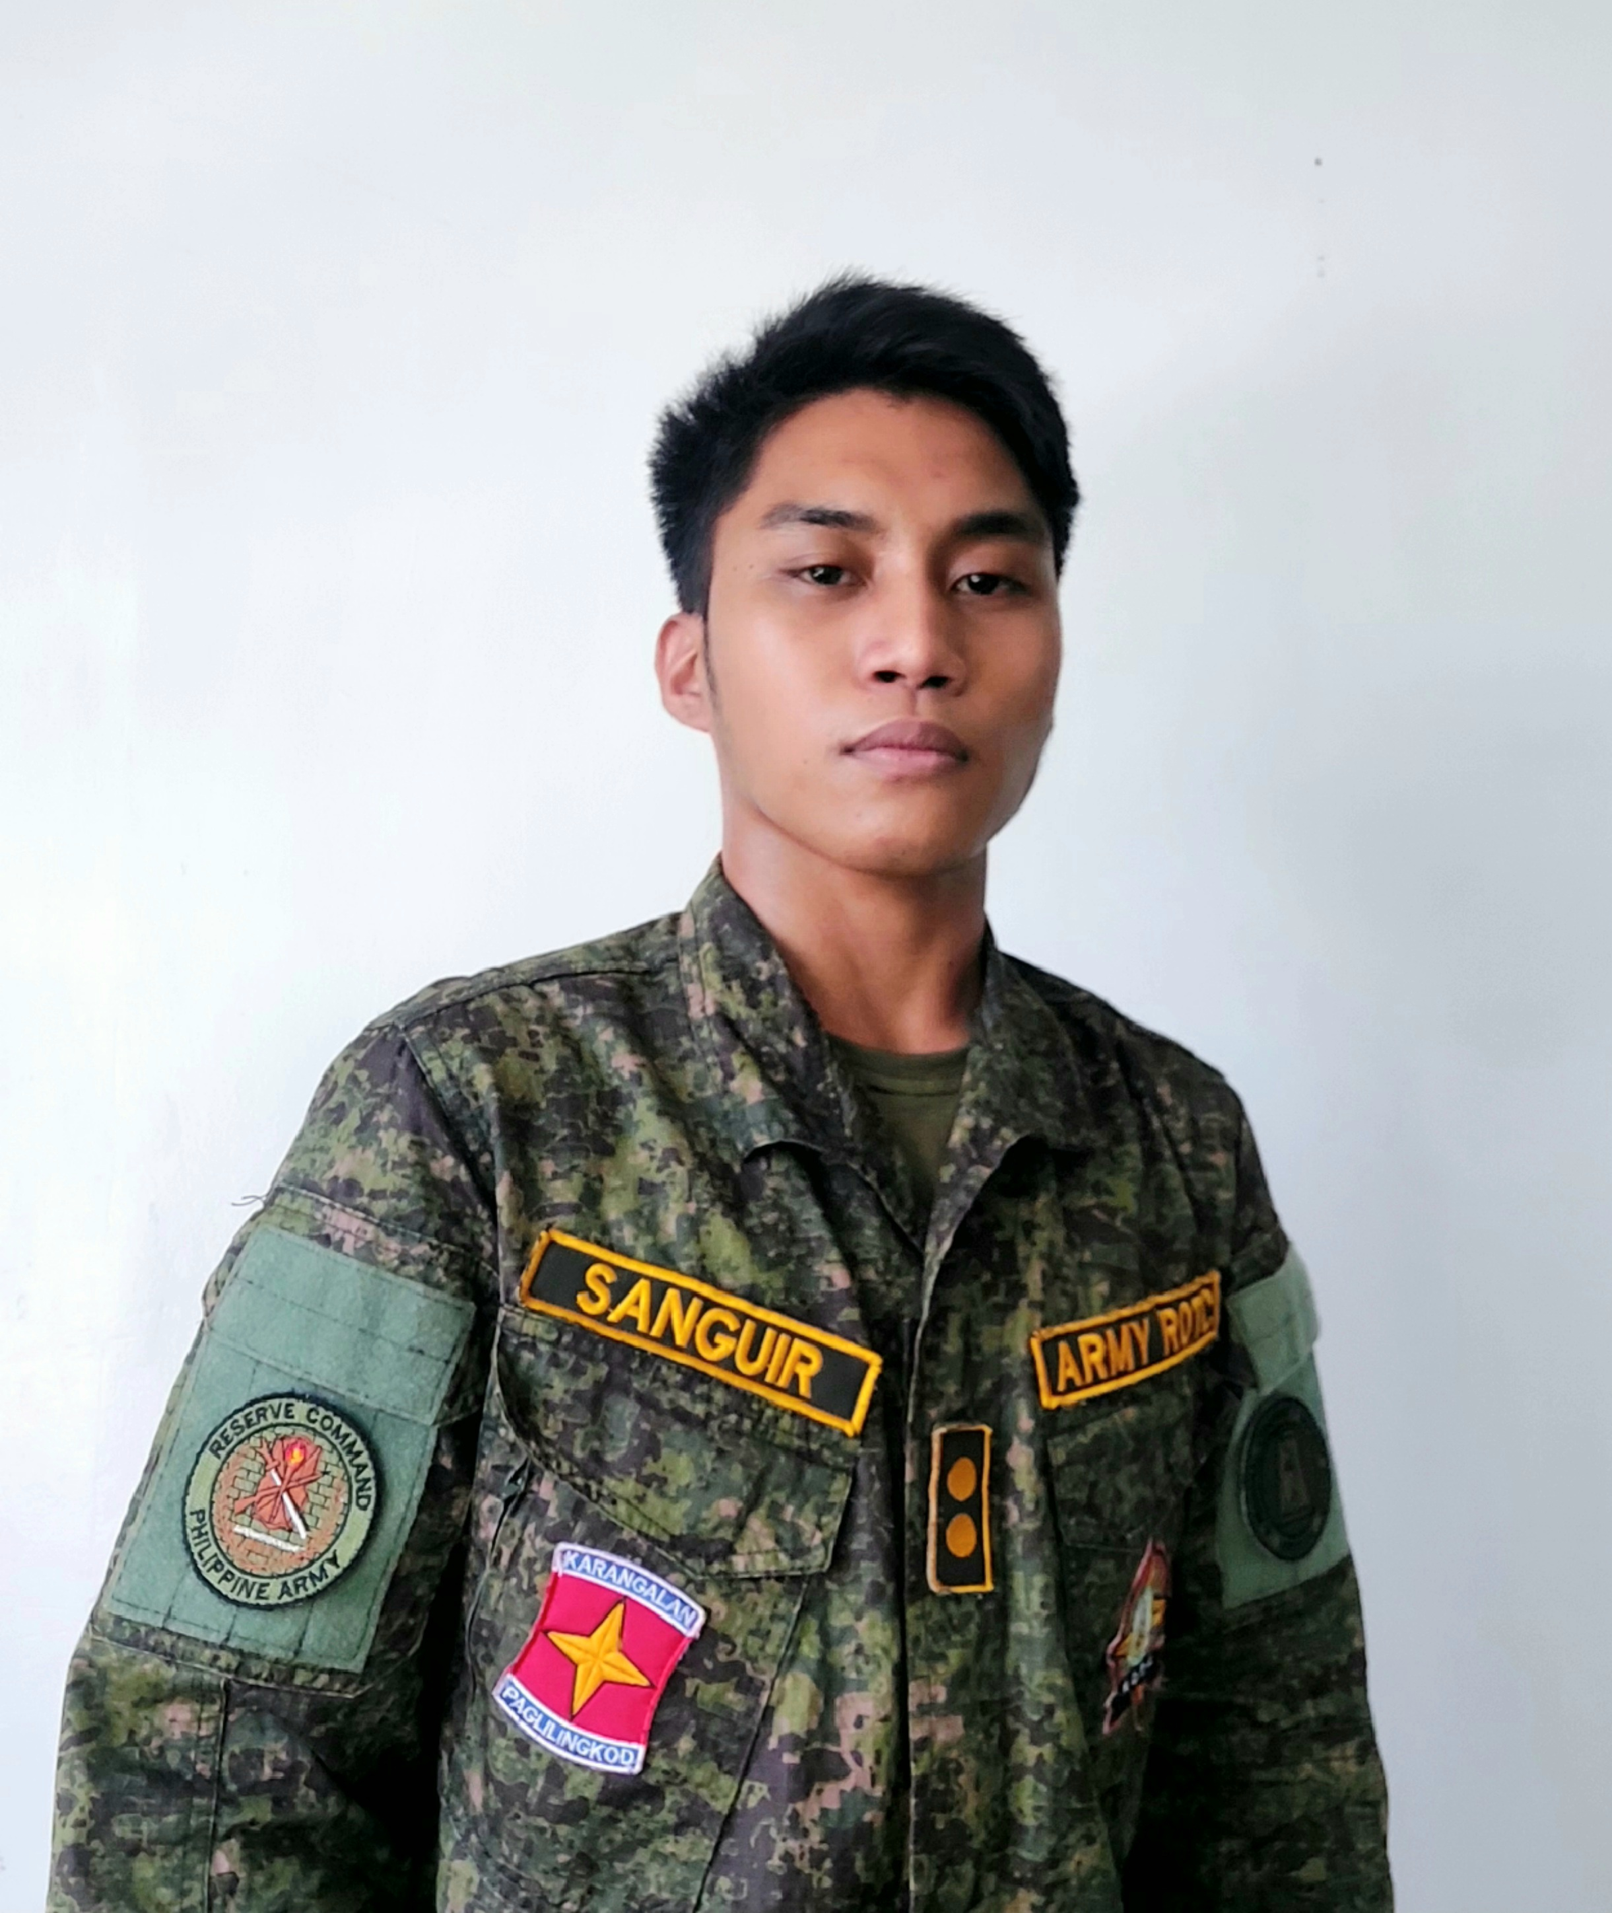
C/CPT CHARLES WINMAR B SANGUIR (ROTC) 2CL
1ST BATTALION LOGISTIC / CMO OFFICER

Slide 28
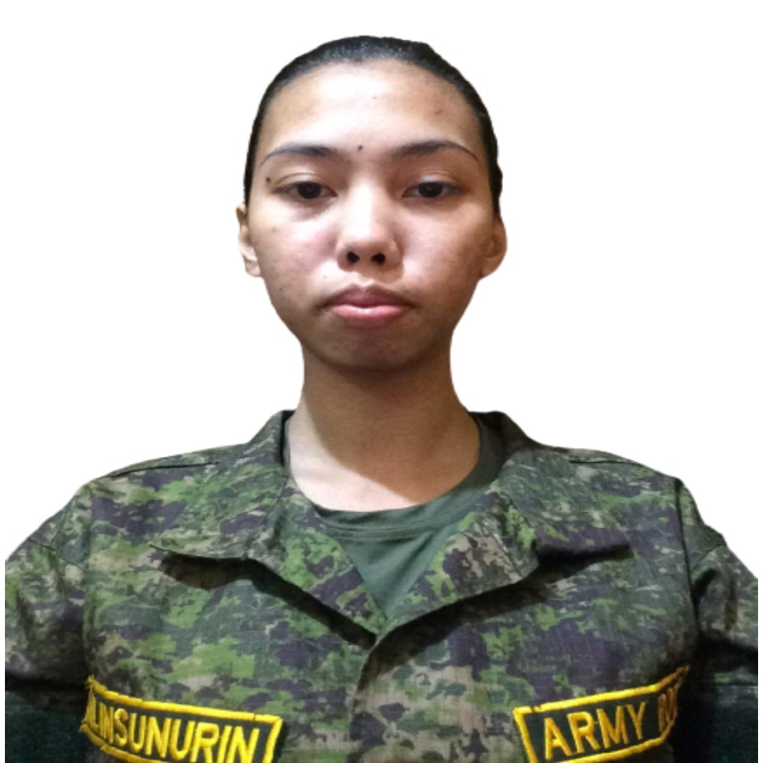
C/MAJ JOANNE D ALINSUNURIN (ROTC) 1CL
2ND BATTALION COMMANDER

Slide 29
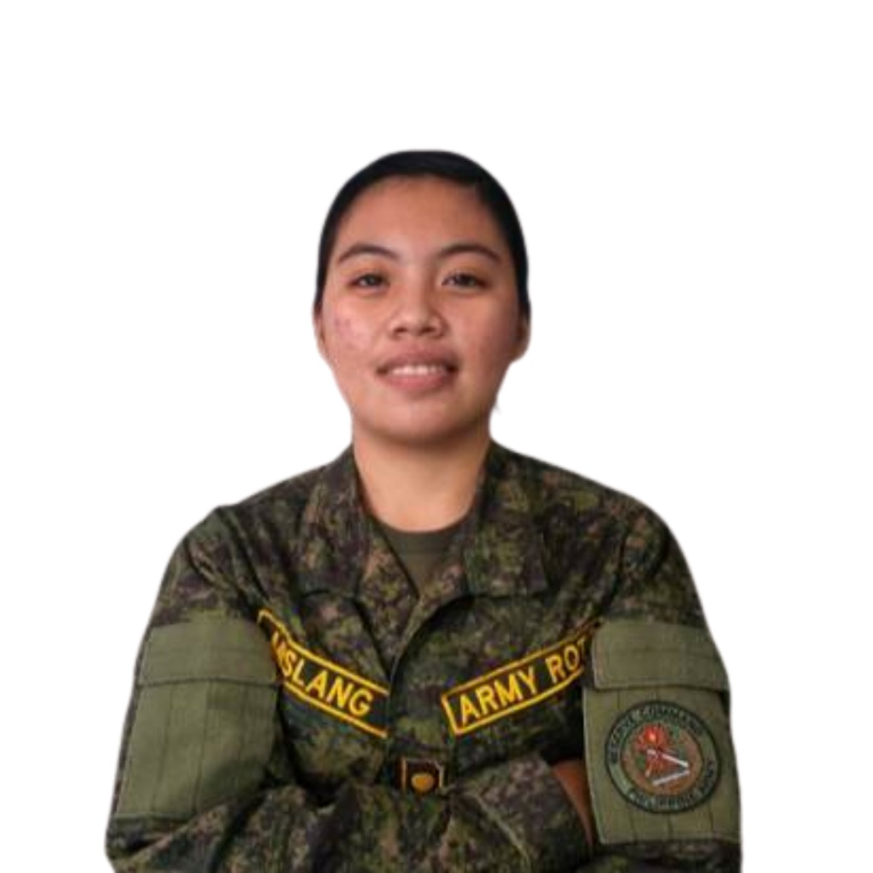
C/CPT ANGELICA A MISLANG (ROTC) 2CL
2ND BATTALION EXECUTIVE / ADJUTANT OFFICER

Slide 30
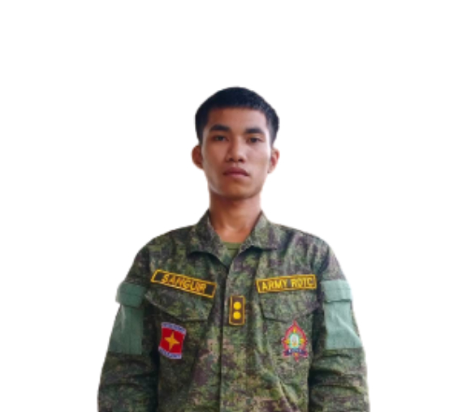
C/CPT GION PAULO SANGUIR (ROTC) 2CL
2ND BATTALION INTELLIGENCE / OPERATION OFFICER

Slide 31
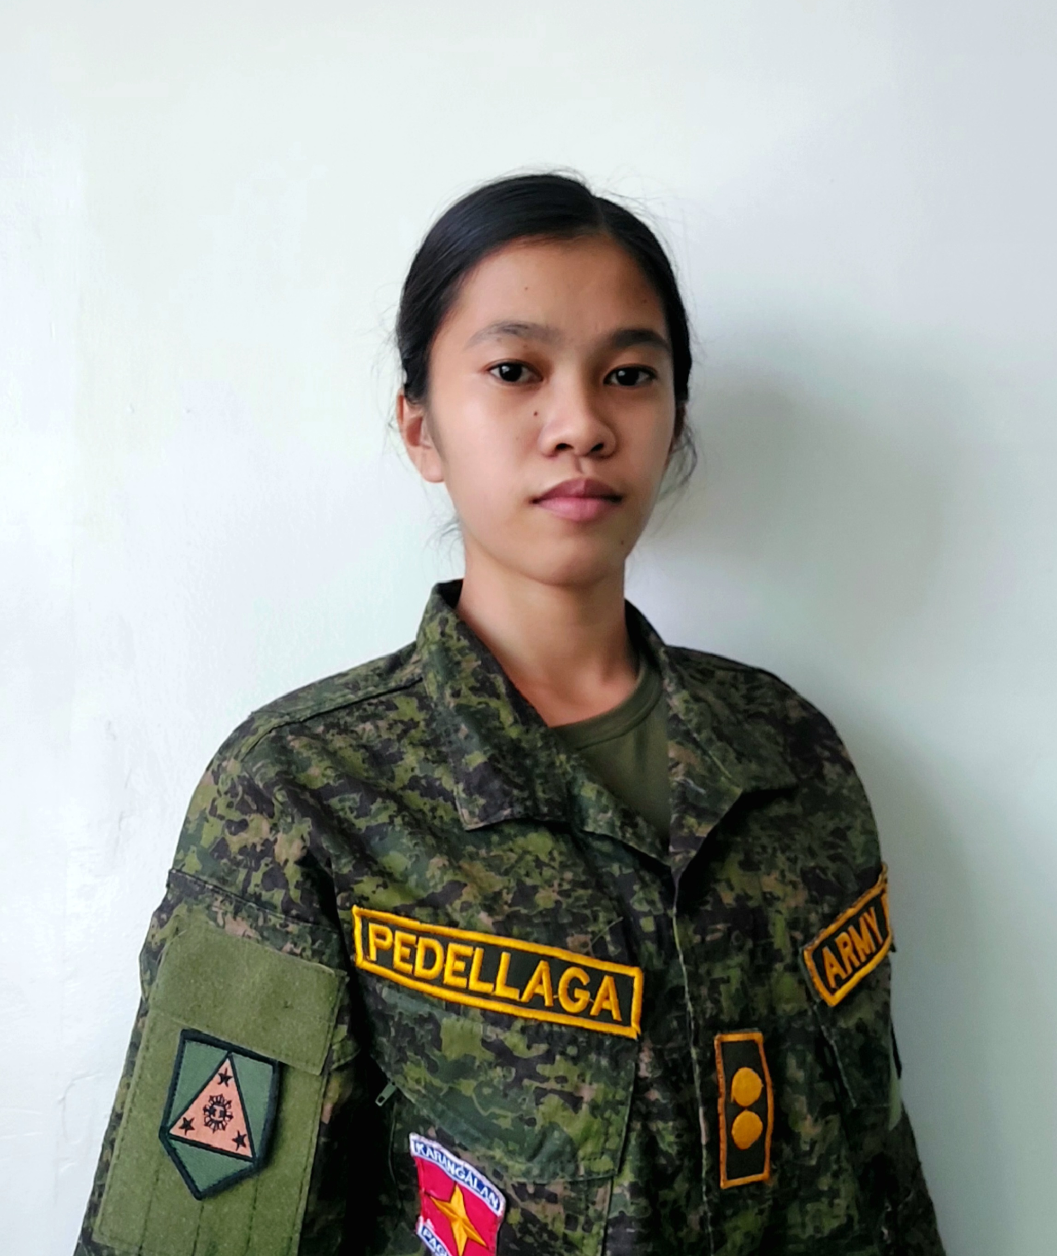
C/CPT MARY JOIE M PEDELLAGA (ROTC) 2CL
2ND BATTALION LOGISTIC / CMO OFFICER

Slide 32
THANK YOU

